Slide 1
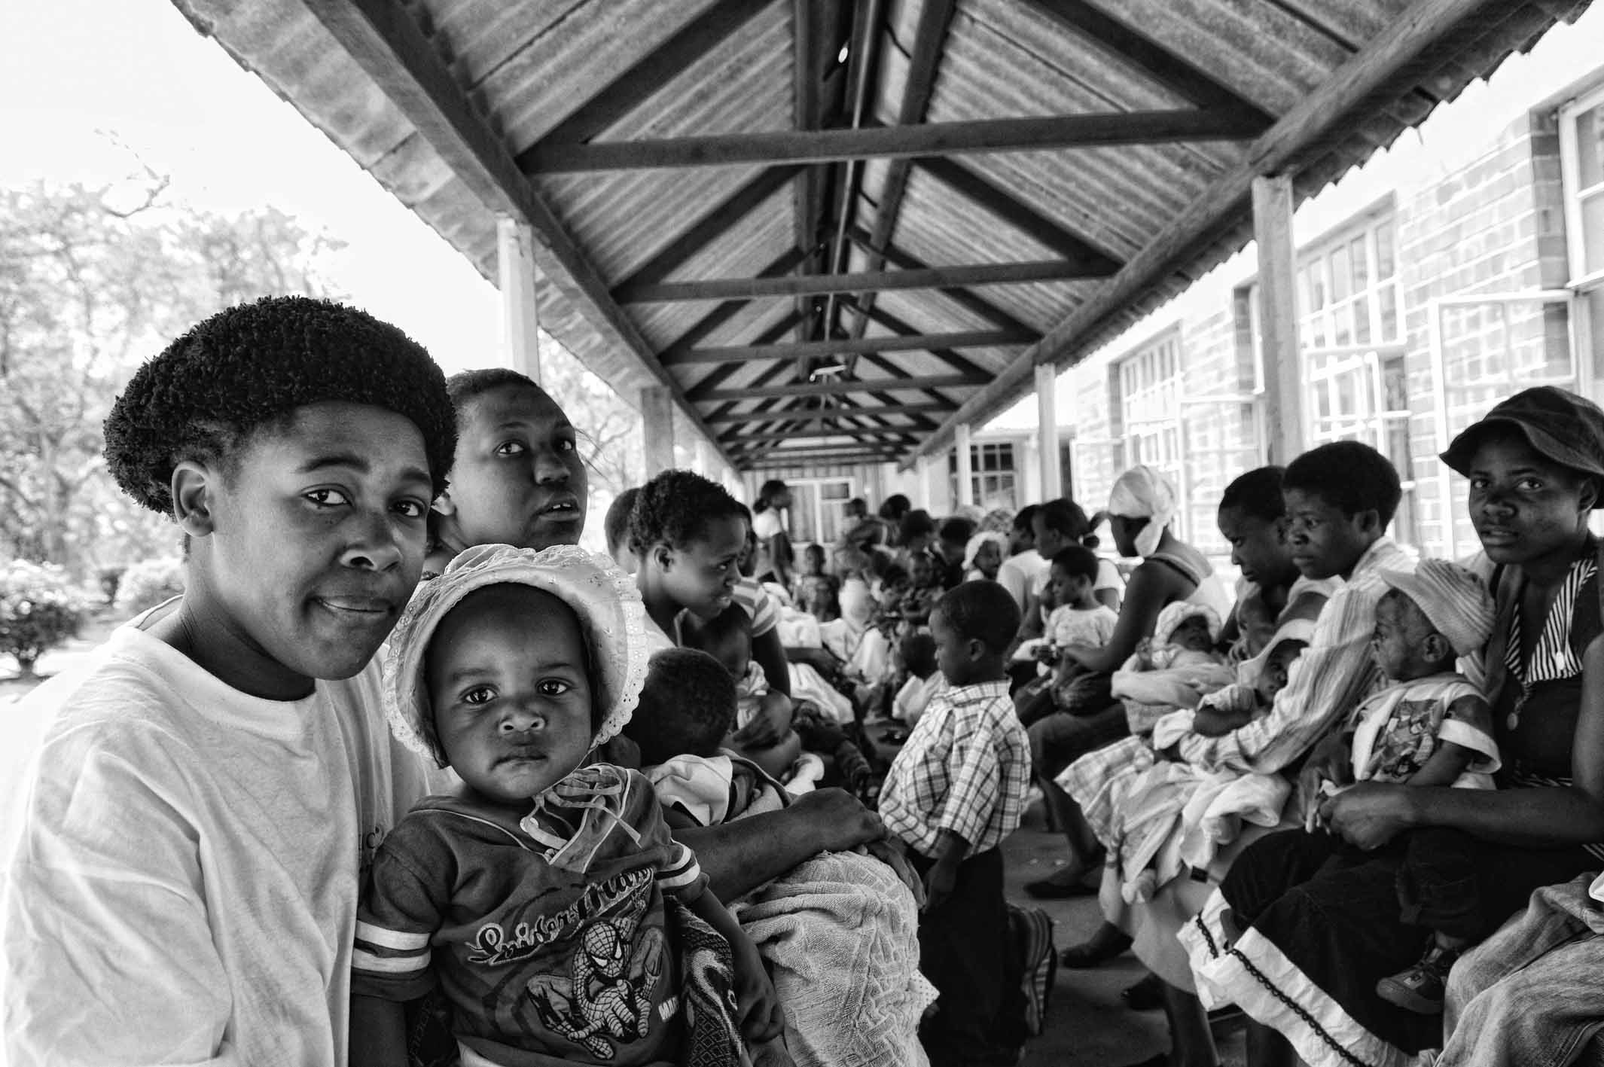
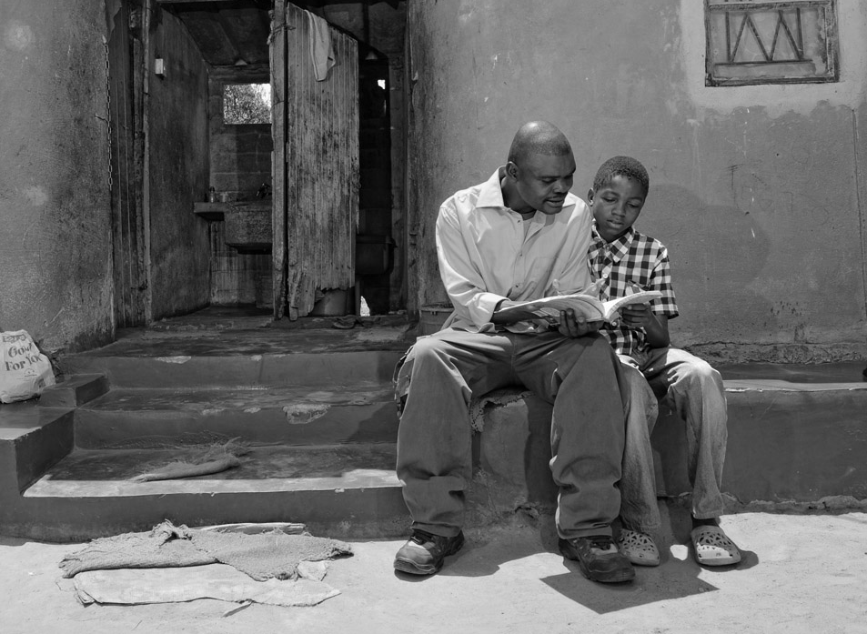
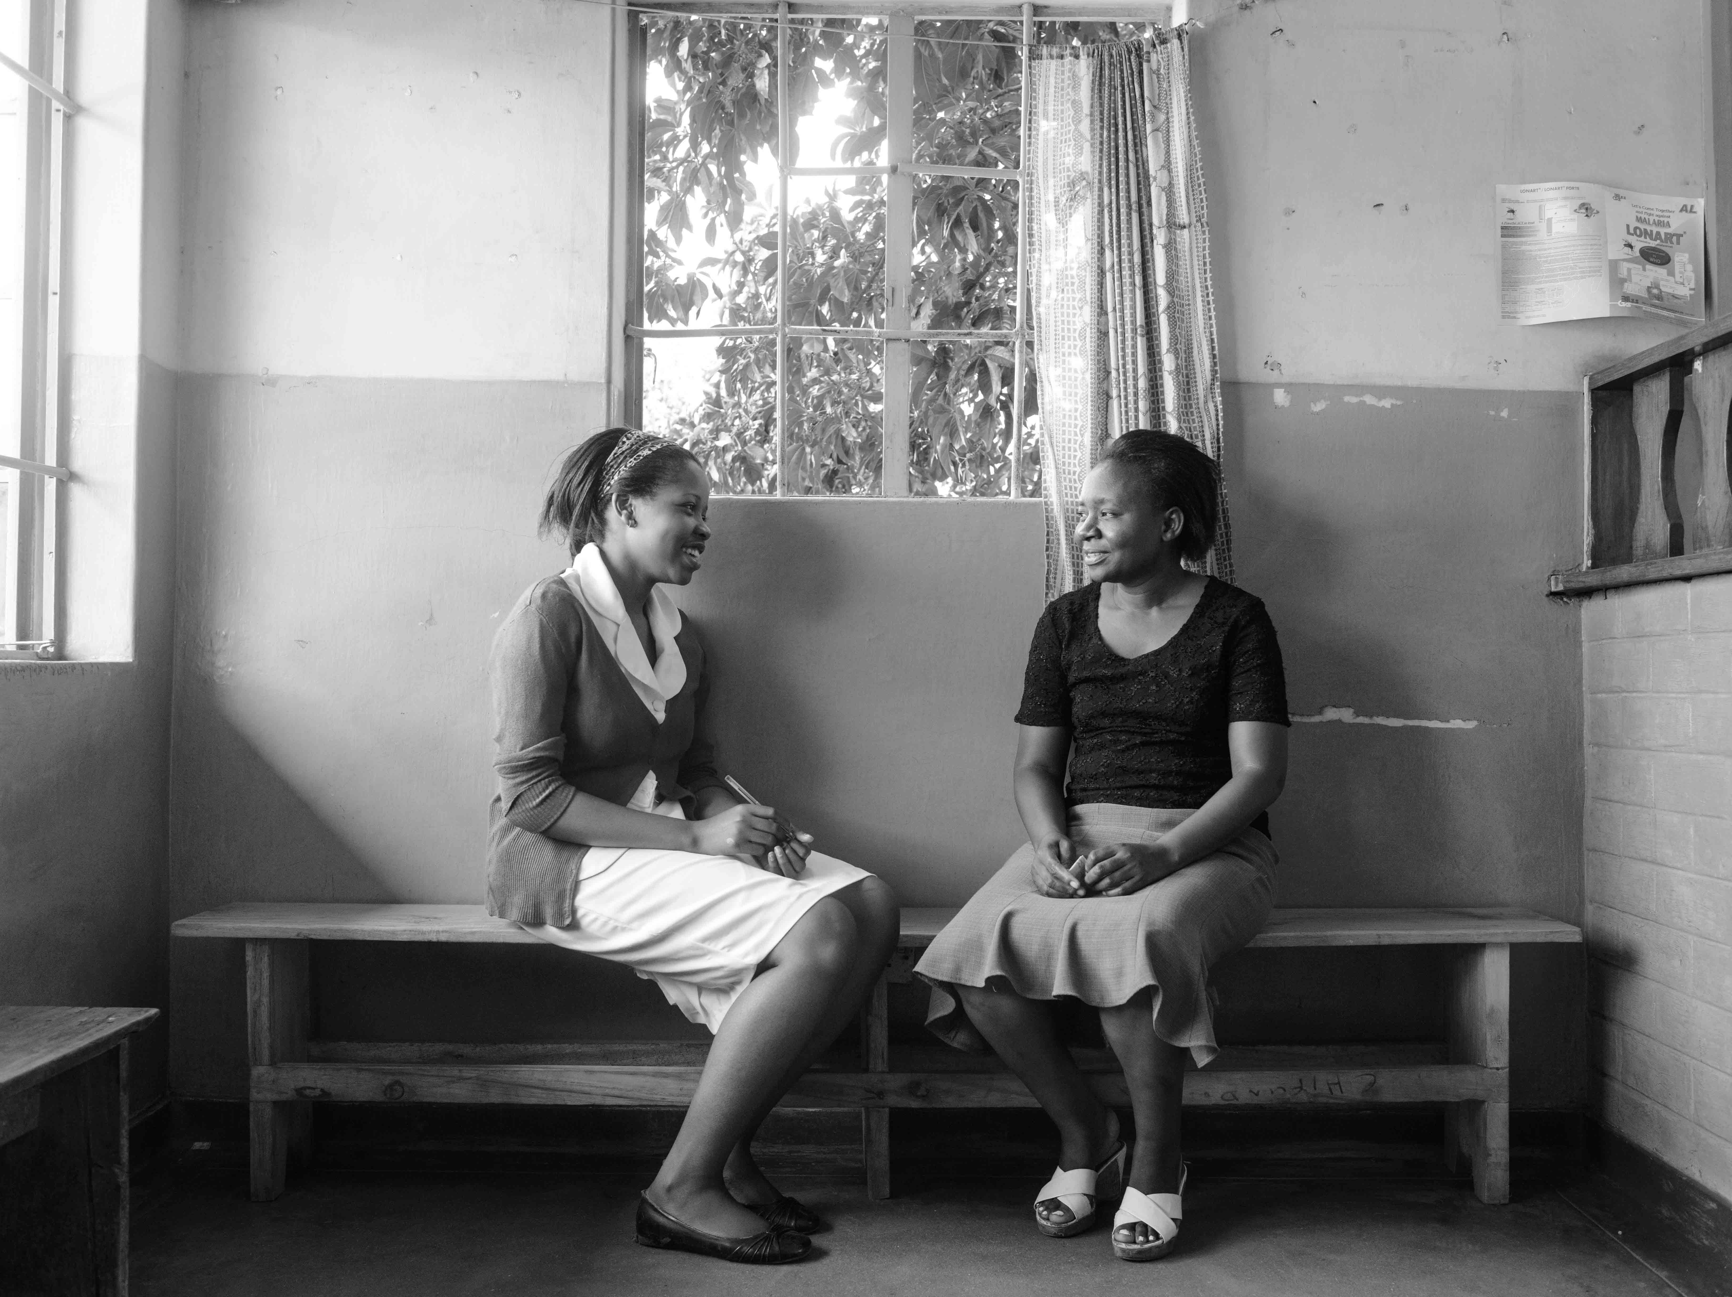
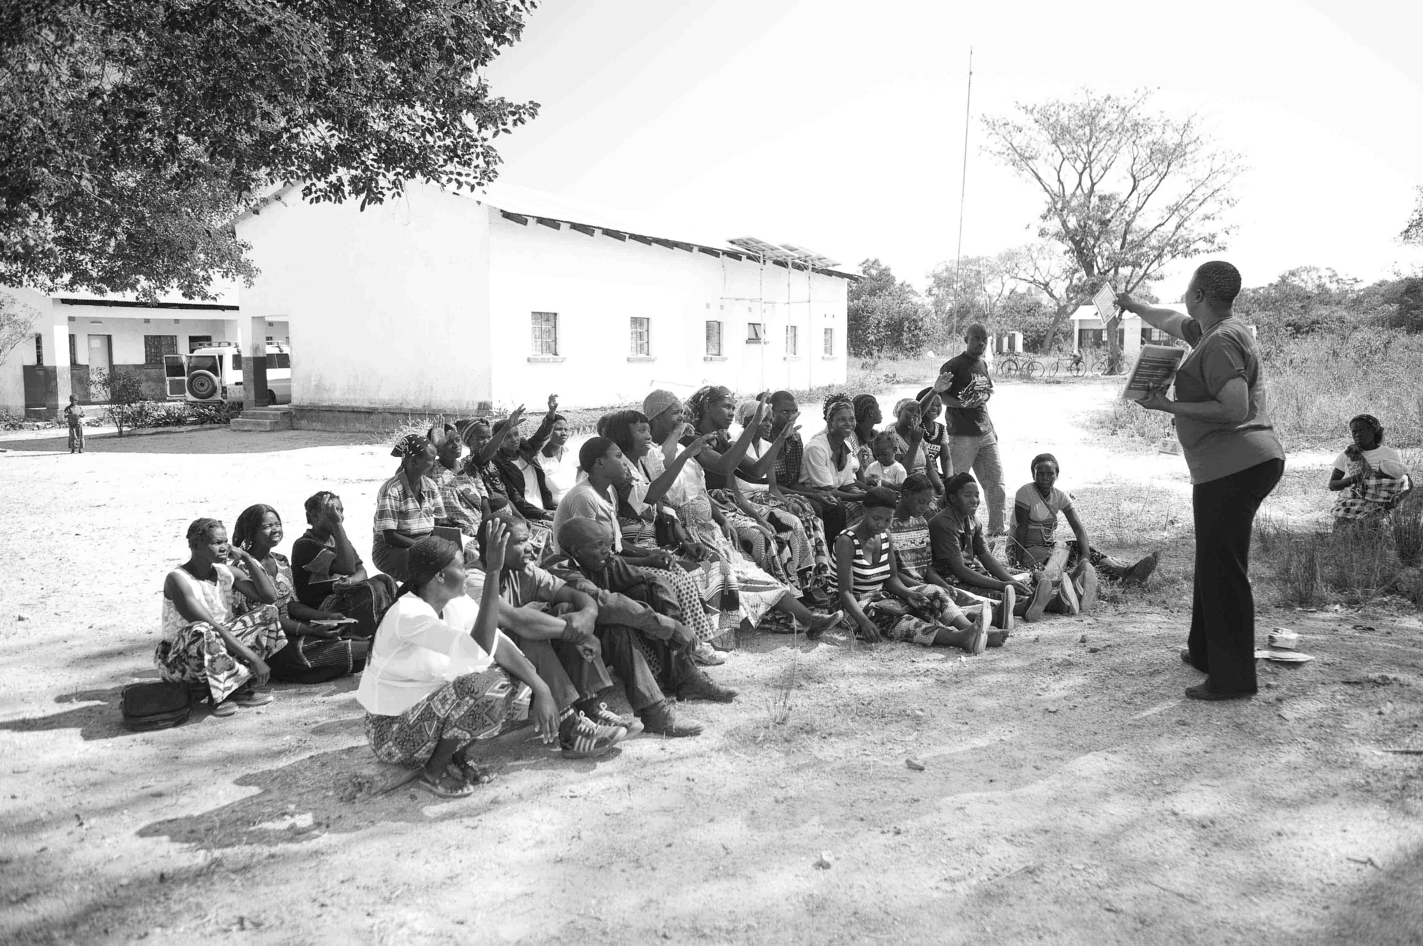
HIV SELF-TESTING AFRICA
HIV self-testing and its potential to increase linkage to VMMC and HIV care among men
Webster Mavhu, CeSHHAR Zimbabwe

Slide 2
Background
Men interact with the health system far less than women
HIV-related consequences are real; men are:
less likely to know their HIV status
diagnosed later in the course of infection (resulting in morbidity and onward transmission)
less adherent to HIV treatment once started
less likely to take up HIV prevention interventions
HIV testing a gateway to accessing interventions for HIV prevention and/or treatment

Slide 3
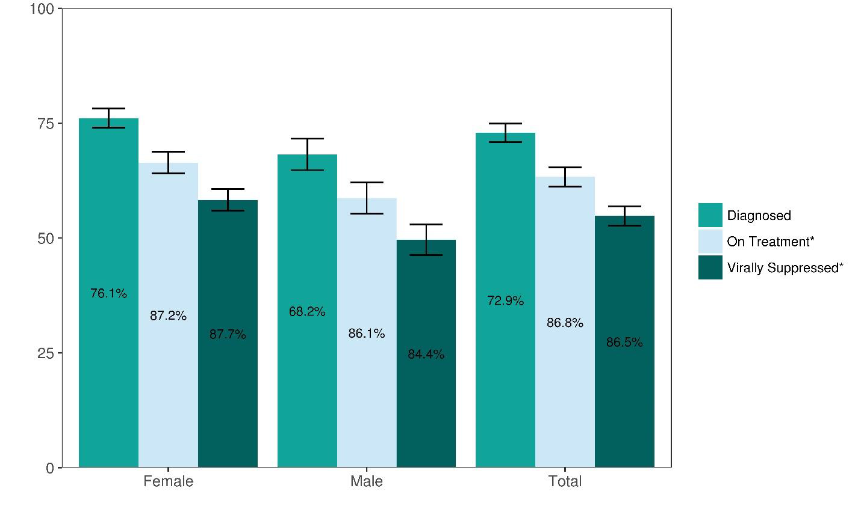
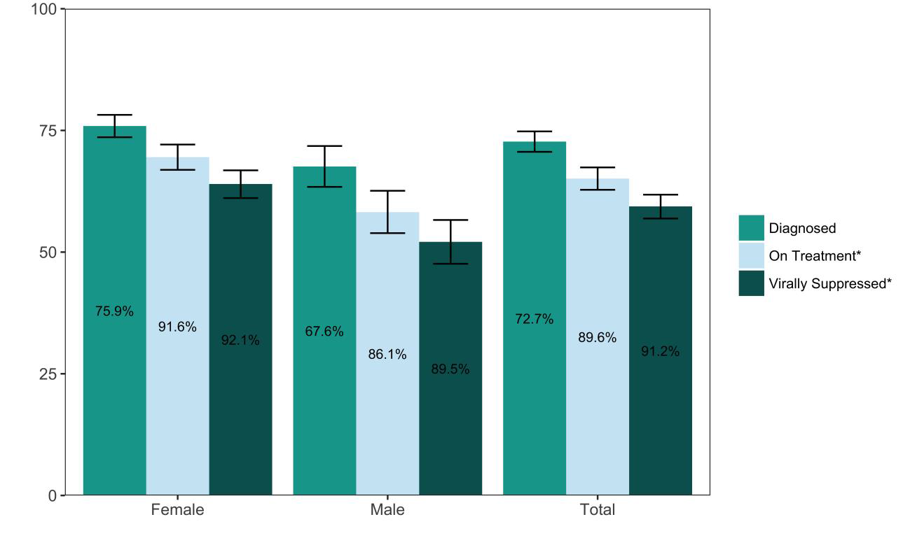
Zimbabwe and Malawi Population HIV Impact Assessments 2015/2016
ZIMPHIA
MPHIA

Slide 4
A BIG intent-action gap – Why?
Sample of 1,165 men, ages 15-49, conducted in October 2013 in Zimbabwe
Awareness → Interest
Interest → Intention
Intention → MC
PSI Research & Metrics, “Zimbabwe (2013): Voluntary Medical Male Circumcision TRaC Study among men and women aged 15 – 49 years in Zimbabwe.” PSI Social Marketing Research Series, (2013)

Slide 5
Barriers to VMMC uptake: population-based survey
Barriers to VMMC by age among males aged 15–49 not willing to be circumcised
Barrier | 15–24 years (n=103) | 25–49 years (n=215) | Total (n=318) | Significance
Fear of pain | 56.3 | 47.0 | 50.0 | p=0.119
I am not a risk of HIV | 14.6 | 13.0 | 13.5 | p=0.707
I am not promiscuous | 10.7 | 20.5 | 17.3 | p=0.031
My primary partner has not asked me | 2.9 | 14.0 | 10.4 | p=0.003
I am worried about costs | 3.9 | 3.3 | 3.5 | p=0.774
Other, including fear of HIV testing and positive test results | 37.9 | 38.6 | 38.4 | p=0.899

Slide 6
Qualitative barriers
Fear of an HIV test was one of the major reasons for not going for VMMC
‘They are saying before you are circumcised you must first get a blood test. That’s what is chasing away most people…’ (uncircumcised older man)
Partners’ influence significant
She [wife] asked ‘why do you want to go for circumcision when you are already married? They say it offers prevention from HIV; where do you think the HIV will come from?’ (uncircumcised older man)
Six-weeks abstinence period a deterrent
‘Do you think it is possible to sleep with your wife in the same blanket for six weeks without having sex?’ (uncircumcised older man)

Slide 7
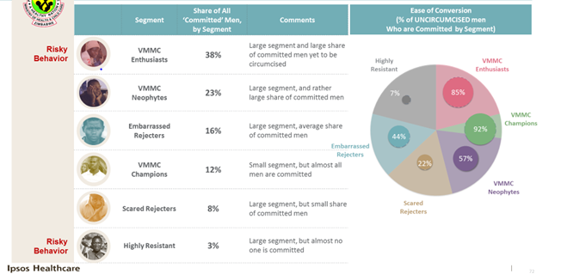
Market Research Quantification/ Segmentation

Slide 8
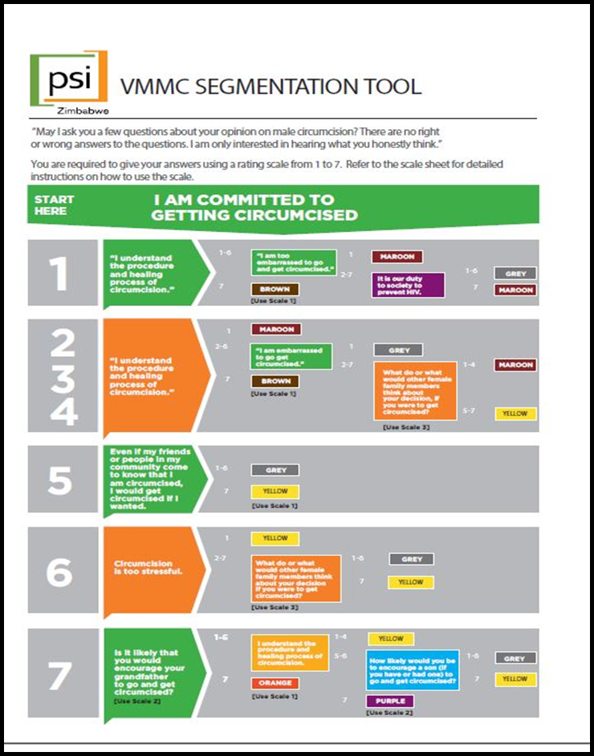
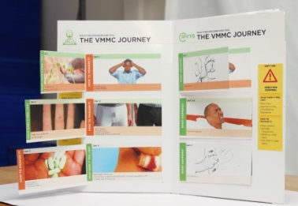
Targeted demand creation: HCD-informed approach
Segmentation Tool
Targeted Messages tailored for each segment
Each segment is unique and requires tailored messages
Painometer

Slide 9
HIVST to increase uptake of HIV prevention/VMMC
Fear of HTS prior to VMMC prevents men from taking up services, especially among older men >20 years *
Pre-screening with HIV self-test might alleviate the fear and increase demand and uptake of VMMC.
HIVST as entry point to engage on VMMC
Unitaid funded STAR Initiative: evaluating public health impact of HIVST and sustainable models of distribution.
VMMC/HIVST model tested in 6 STAR countries
* Hatzold, Mavhu, Chatora, Cowan, et al. “Barriers and Motivators to Voluntary Medical Male Circumcision Uptake among Different Age Groups of Men in Zimbabwe: Results from a Mixed Methods Study.” PLoS ONE, 2014, 9(5):

Slide 10
Innovation: HIV self-testing within VMMC mobilization
Within cRCT to test innovative VMMC demand creation strategies, mobilizers offered HIVST kits to potential clients
Follow up telephone interviews with men who were offered HIVST kits at 4 weeks after obtaining kit to explore
uptake of HIV Testing
linkage to ART
linkage to VMMC
12 in-depth interviews with mobilizers
6 focus group discussions (n=4 with men; n=2 with mobilizers)

Slide 11
Results: HIV self-testing within VMMC mobilization
3,296 men reached by mobilizers offering HIVST
all should have been offered access to an HIVST
Telephone contact details collected from all men who had access to a phone
many either declined or gave a false phone number
283 (8.6%) contacts with men for follow up questionnaire on self-test uptake, use and linkage into VMMC/ART

Slide 12
HIVST Survey results
Men surveyed | N=283
Men offered HIVST kits | n=283; 200 (71%)
Men accepting HIVST kits | n=200; 153(77%)
Men reporting kits use | n=153; 141 (92%)
Men reporting taking up VMMC | n=141; 37 (26%)
Men with reactive HIV result | n=141; 6 (4%)
Men with reactive result reporting linking to care | n=6; 3 (50%)

Slide 13
Qualitative results – HIVST
Clients said it offers men who rarely visit facilities an opportunity to test
once they test HIV-ve, gives them “confidence” to visit VMMC facility
Men preferred HIVST to provider-delivered testing due to privacy & confidentiality concerns
Mobilizers stated - once men test HIV -ve, they are better able to persuade them to undergo VMMC
HIVST was unusually acceptable to certain religious groups that otherwise resist biomedical interventions
Both mobilizers and clients felt some men were more interested in HIVST but less in VMMC
18/153 (12%) accepted VMMC-related HIVST when they were already circumcised

Slide 14
Summary and Conclusions
HIVST offers men, who rarely visit health facilities, an opportunity to test for HIV
HIVST enables VMMC mobilizers to reach men for both testing and VMMC
HIVST should be available in communities where VMMC is promoted
Other possible interventions
Combining VMMC with other interventions (PrEP)
Innovative approaches (e.g. mHealth strategies) to improve linkages from HIVST to VMMC

Slide 15
Acknowledgements
MOHCC Zimbabwe
Unitaid and BMGF
STAR Consortium partners
WHO
The beneficiaries

